Slide 1
Effective Presentation Skills

Slide 2

“There are always three speeches, for every one, The one you practiced, the one you gave, and the one you wish to give.”

Slide 3



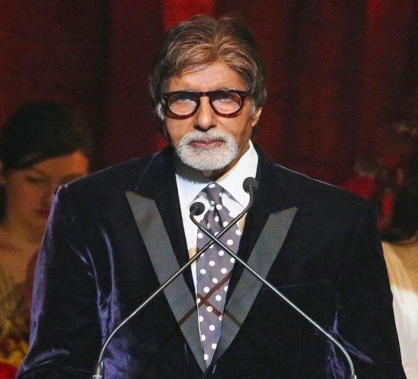

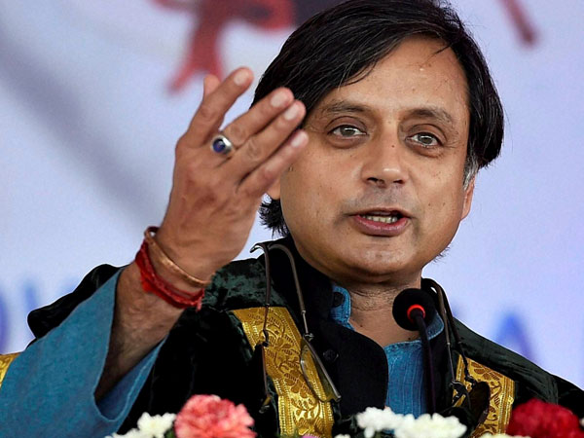

Slide 4
Polished Prose
Elegant Logic
Highly Developed Craft
Smooth Delivery

Slide 5
BEST WAYS TO START A PRESENTATION
STORIES
QUESTIONS/ CASE STUDY
VIDEOS
ACTIVITY
QUOTE
EXPERIENCE

Slide 6

4 P’s of Presentation.

Slide 7
PLAN
PREPARE
PRESENT
PRACTICE

Slide 8
6 main purposes of presentation
Instruct
Stimulate
Inform
Motivate
Entertain
Persuade

Slide 9

TIME ALLOCATION

Slide 10
AUDIENCE
Why am I giving the presentation?
What do I want the audience to gain from the
presentation?

Slide 11
3 Essentials of Successful Presentation
EDUCATE: The audience should learn something from your speech or presentation
ENTERTAIN: The audience should enjoy your speech or presentation
EXPLAIN: All parts of your speech or presentation should be clear to your audience

Slide 12
Audience Attitude
Like you and like your subject
Like you but dislike your subject
Dislike you but like your subject
Dislike both you and your subject
Like or dislike you but be neutral about your subject
Be neutral about you and like or dislike your subject
be neutral about you and your subject

Slide 13
Presentation planning checklist
Does your introduction grab the participant’s attention and explain your objectives?
Do you follow this by clearly defining the points of the presentation?
Are the main points in logical sequence?
Do the main points flow well?
Do the main points need support from visual aids?
Does your closing summarize the presentation clearly and concisely?
Is the conclusion strong?
Have you tied the conclusion to the introduction?

Slide 14
Prepare
PREPARING YOURSELF
PREPARING MATERIAL

Slide 15
Preparing Material

Slide 16
The Golden Circle
WHY ?
HOW ?
WHAT ?

Slide 17
Questions
WHY
WHAT
WHO
HOW
WHERE
WHEN

Slide 18
Preparing Yourself

Slide 19


First Impression
Smile please
Dress Well
Use a right formal combination
Be proactive
make your style
Be humble

Slide 20
Practice
1. MIRROR EXERCISE
2. RECORDING SESSION
3. TAKE THE FEEDBACK FROM AUDIENCE
4. FREE DEMOS

Slide 21
Present
1. Deliver the experience with
( Authority, Confidence, Energy)

Slide 22
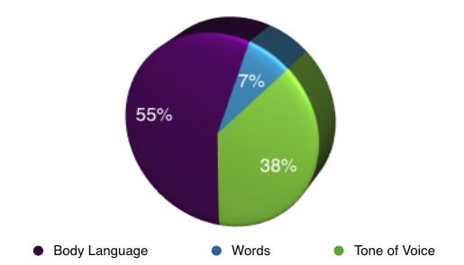
UNDERSTANDING THE 7-38-55 RULE

Slide 23
SPEAKING POWERFULLY
PITCH
PACE
VOLUME
MODULATION
TONE

Slide 24
Presentation Delivery Checklist
Are you knowledgeable about the topic covered in your presentation?
Do you have your notes in order?
Where and how will you present? (Indoors, outdoors, standing, sitting etc.)
Have you visited the presentation site?
Have you checked your visual aids to ensure they are working and you know how to use them?

Slide 25
Tips for achieving Excellence

Slide 26
Learning Styles
Auditory Learners
Visual Learners
Kinesthetic Learners

Slide 27
TYPES OF AV AIDS
Low Complexity: Handouts, writing board, flip-chart
Medium Complexity: Slide projector, OHP, Audio system
High Complexity- VIDEO, Multimedia, Computer graphics

Slide 28
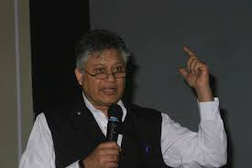
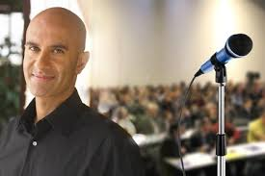
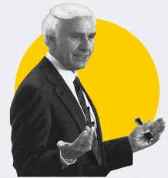
Have a role model

Slide 29
KISS
Keep
It
Short
&
Simple

Slide 30
Tell Them Structure

Slide 31
6 * 7 Rule
No more than 6 lines per slide.
No more than 7 words per line.

Slide 32
Rapport building
People are interested in themselves and not in you
Talk to them and let them talk about themselves
WIIIFM
Common Ground/Interest
Small talk
Transparency
Matching and Mirroring

Slide 33
If you want the learner to understand
Articles
Lectures
Diagrams
Instruction
Videos.

Slide 34
If you want the learner to do:
Case studies
Demonstration
Role plays
Exercises
Work sheets
Actual skill

Slide 35
If you want the learner to change their values & attitudes.
Role plays
Games
Self-analysis/Awareness
Activities

Slide 36
If you want the learner to develop a capacity for creativity:
Brainstorming
Activities
Unstructured
Games
Problem-solving
Activities

Slide 37
People will forget what you said, people will forget what you did, but people will never forget how you made them feel
Maya Angelou

Slide 38
VIDEO LINK
https://www.youtube.com/watch?v=uvsuAZFem88&t=266s – steve jobs
https://www.youtube.com/watch?v=2-ntLGOyHw4 – present like steve jobs
https://www.youtube.com/watch?v=mpfxsvBPWEs - Sundar Pichai

